Slide 1
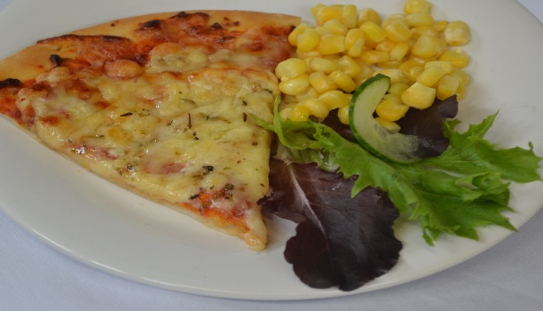
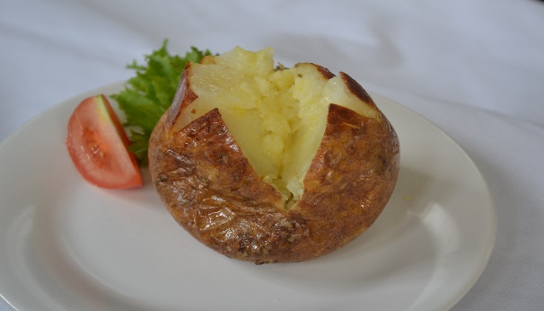
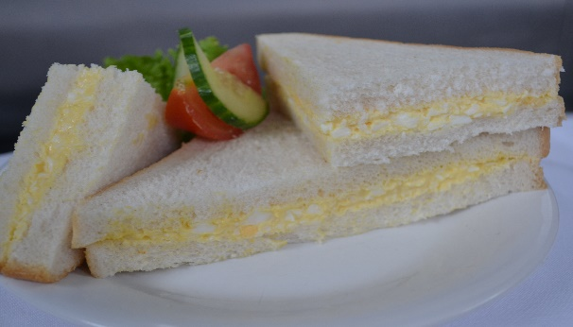
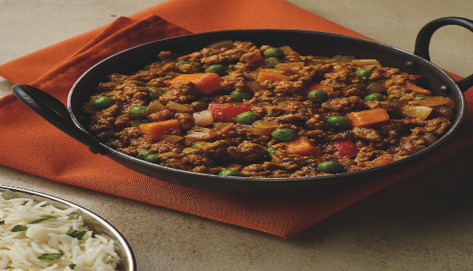
Week 1 Monday
English Martyrs Primary School
Filled
Jacket Potato Choice of Cheese or Baked Beans
Cheese & Tomato
Pizza
Red
Yellow
Quorn
Keema
Curry
Egg Sandwich
Green
Blue

Slide 2
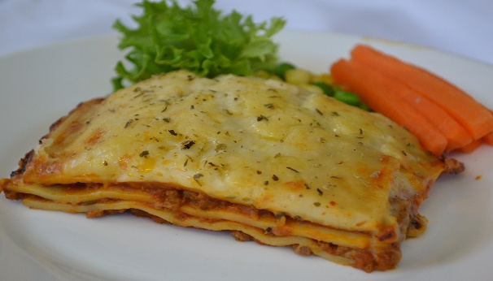

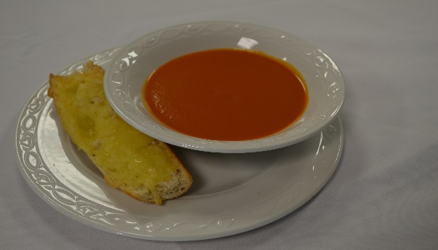
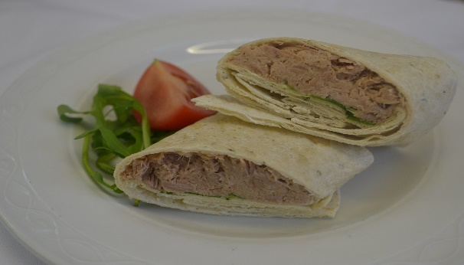
Week 1 Tuesday
Week 1 Tuesday
English Martyrs Primary School
Beef Lasagne
Filled Jacket Potato Choice of Cheese
Baked Beans or Tuna
Red
Tomato
Soup
Tuna Mayo Wrap
Green
Lentil & Tomato Soup
Blue
Orange

Slide 3
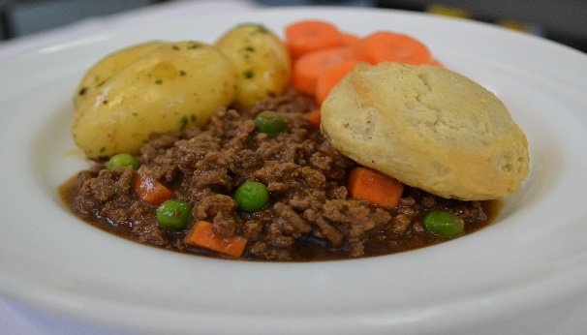

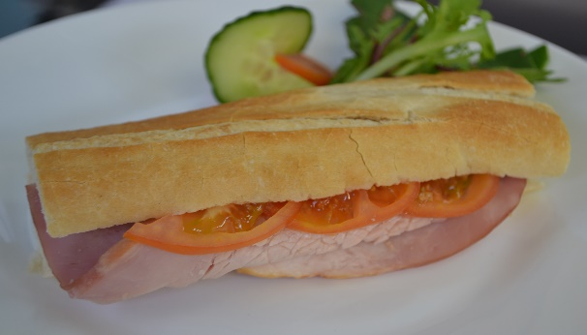
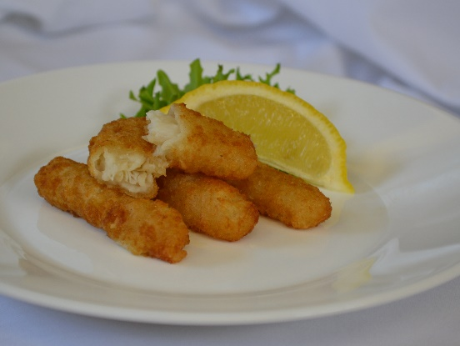
Week 1 Wednesday
Week 1 - Wednesday
Week 1 Wednesday
English Martyrs Primary School
Filled Jacket Potato Choice of Cheese
Baked Beans
or Tuna
Mince & Dumpling
Red
Yellow
Red
Southern Fried Meat Free Dippers
Ham & Tomato Baguette
Green
Blue

Slide 4
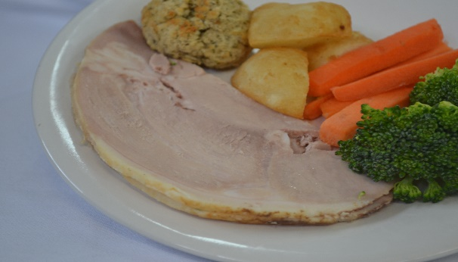
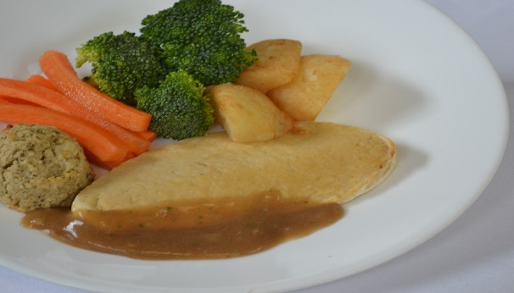
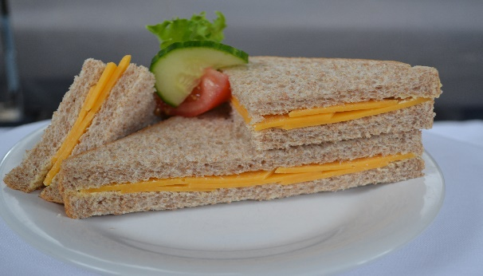
Week 1 Thursday
Week 1 - Thursday
Week 1 Thursday
English Martyrs Primary School
Filled Jacket Potato Choice
of Cheese
Baked Beans
or Tuna
Roast Turkey
with Sage & Onion Stuffing
Yellow
Red
Quorn Fillet with Sage & Onion Stuffing
Cheese
Sandwich
Blue
Green

Slide 5
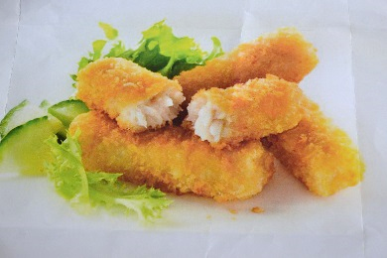
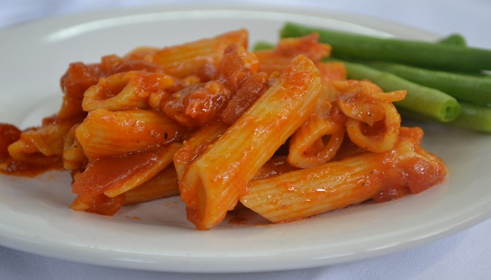
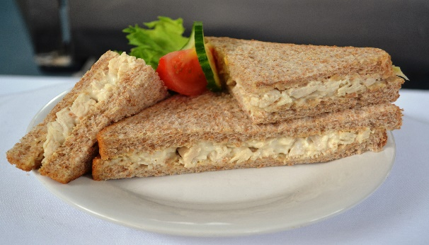
Week 1 Friday
Week 1 - Friday
Week 1 Friday
English Martyrs Primary School
Fish
Fingers
Filled Jacket Potato
Choice of Cheese
Baked Beans
or Tuna
Red
Yellow
Blue
Tomato & Mascarpone
Pasta
Chicken Mayo Sandwich
Green
Blue

Slide 6
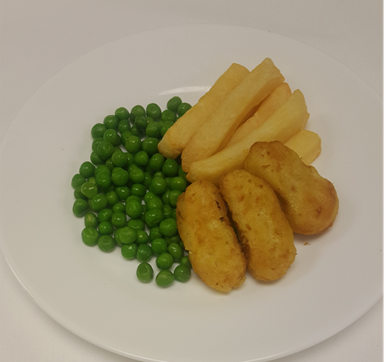
Week 2 Monday
Week 2 - Monday
Week 2 Monday
English Martyrs Primary School
Filled Jacket Potato
Choice of Cheese or Baked Beans
Pasta
Pomodoro
Red
Red
Yellow
Vegetable
Fingers
Egg Mayo Sandwich
Green
Blue

Slide 7
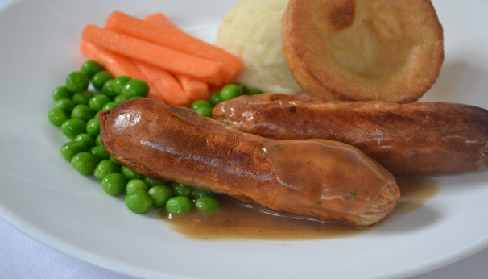
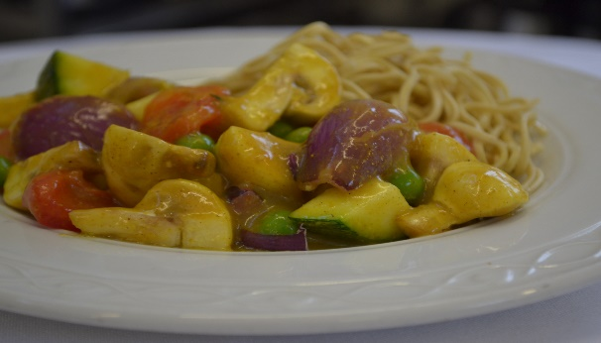
Week 2 Tuesday
Week 2 - Tuesday
Week 2 Tuesday
English Martyrs Primary School
Filled Jacket Potato
Choice of Cheese
Baked Beans
or Tuna
Pork Sausages
Red
Yellow
Chinese Style
Vegetable
Curry
Tuna Mayo
Wrap
Blue
Green

Slide 8
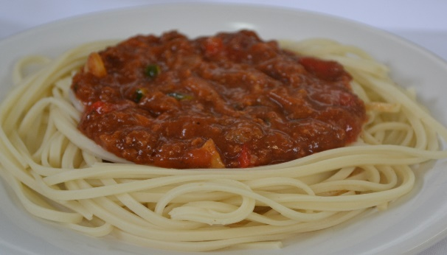

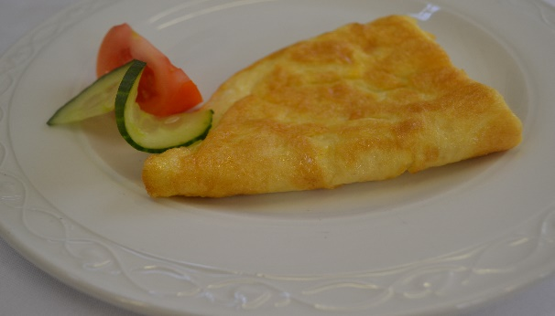
Week 2 Wednesday
Week 2 - Wednesday
Week 2 Wednesday
English Martyrs Primary School
Filled Jacket Potato Choice of Cheese
Baked Beans
or Tuna
Spaghetti Bolognese
Red
Yellow
Cheese
Omelette
Ham & Tomato Baguette
Green
Blue

Slide 9
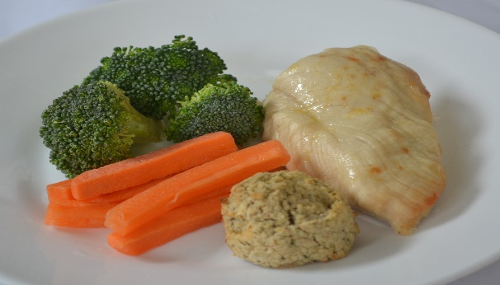
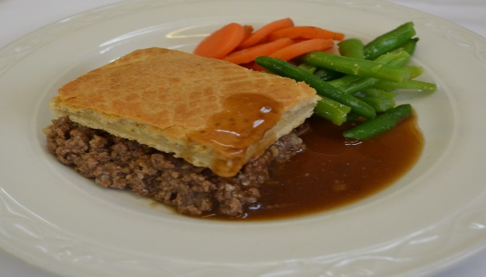
Week 2 Thursday
Week 2 - Thursday
Week 2 Thursday
English Martyrs Primary School
Filled Jacket Potato Choice of Cheese
Baked Beans
or Tuna
Chicken
Fillet
Red
Red
Yellow
Quorn & Vegetable
Pie
Cheese
Sandwich
Green
Blue

Slide 10
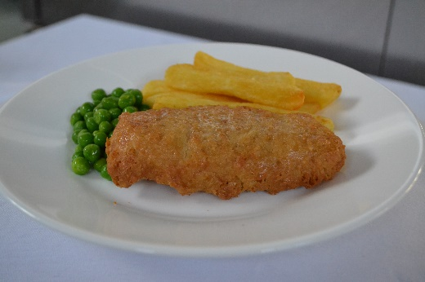
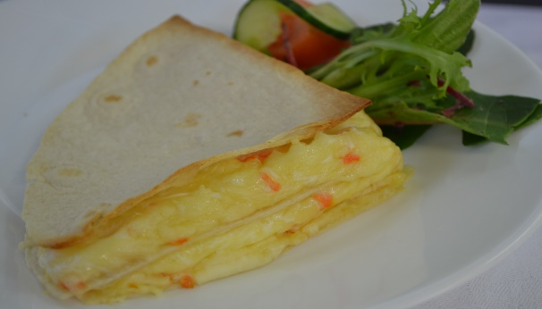
Week 2 Friday
Week 2 - Friday
Week 2 Friday
English Martyrs Primary School
Battered
Fish
Filled Jacket Potato
Choice of Cheese
Baked Beans
or Tuna
Red
Blue
Yellow
Cheese Tortilla Wedge
Chicken Mayo Sandwich
Green
Blue

Slide 11
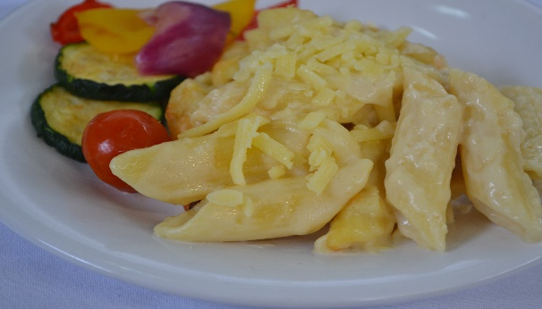
Week 3 Monday
Week 3 - Monday
Week 3 Monday
English Martyrs Primary School
Macaroni Cheese
Filled Jacket Potato
Choice of Cheese
Baked Beans
Red
Yellow
Fishless Fingers
Egg Mayo Sandwich
Green
Blue

Slide 12
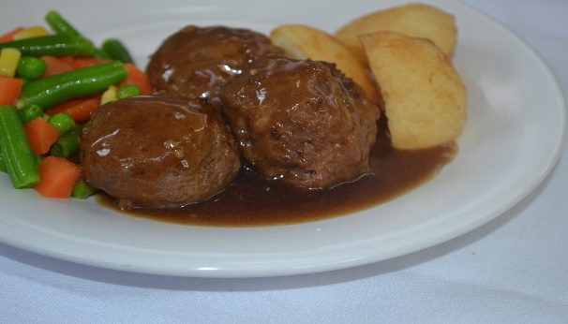
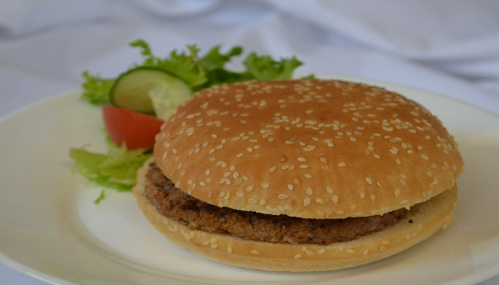
Week 3 Tuesday
Week 3 - Tuesday
Week 3 Tuesday
English Martyrs Primary School
Filled Jacket Potato
Choice of Cheese
Baked Beans
or Tuna
Meatballs in Gravy
Red
Red
Yellow
Vege Burger
in a Bun
Tuna Mayo Wrap
Green
Blue

Slide 13
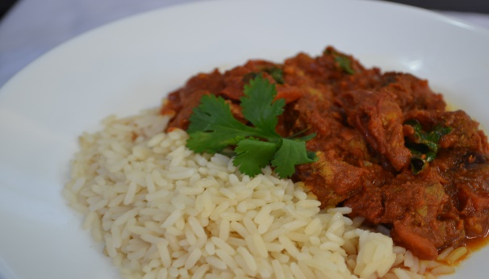
Week 3 Wednesday
Week 3 - Wednesday
Week 3 Wednesday
English Martyrs Primary School
Filled Jacket Potato
Choice of Cheese
Baked Beans
or Tuna
Chicken
Jalfrezi
Red
Red
Yellow
Pizza Margherita
Ham & Tomato Baguette
Green
Blue

Slide 14
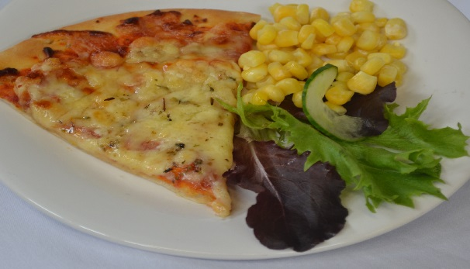

Week 3 Thursday
Week 3 - Thursday
Week 3 Thursday
English Martyrs Primary School
Filled Jacket Potato
Choice of Cheese
Baked Beans
or Tuna
Minced
Beef Pie
Red
Yellow
Pasta
Arrabiata
Cheese Sandwich
Green
Blue

Slide 15
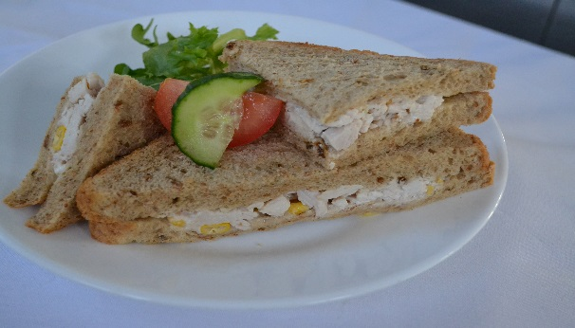

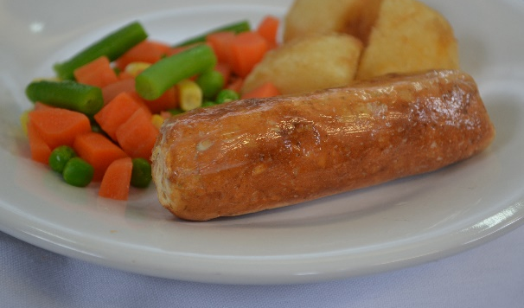
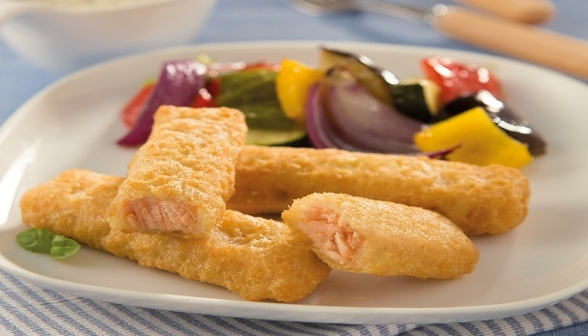
Week 3 Friday
Week 3 - Friday
Week 3 Friday
English Martyrs Primary School
Fish
Goujons
Filled Jacket Potato Choice of Cheese Baked Beans
or Tuna
Blue
Yellow
Red
Quorn
Sausage
Chicken
Mayo
Sandwich
Green
Blue

